Slide 1
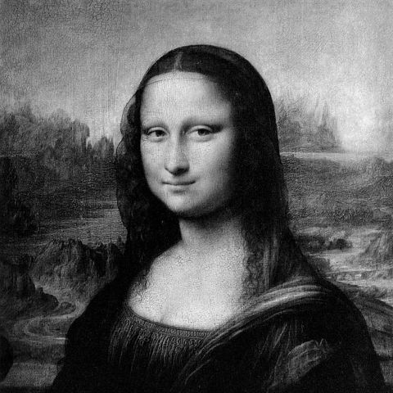
HOW DO WE DIGITALLY REPRESENT AN IMAGE?: GREYSCALE
A greyscale image is system of 256 tones with values ranging from 0-255.
'0' represents black and '255' represents white.
Numbers in-between represents greys between black and white.
Binary systems use digits '0' and '1‘ where '00000000' for black, to '11111111' for white (8-bit image).
Note: binary value of '11111111' is equal to decimal value of '255'
255 | 255 | 255
155 | 155 | 155
0 | 0 | 0
11111111 | 11111111 | 11111111
10011011 | 10011011 | 10011011
00000000 | 00000000 | 00000000
Photo Credit: http://shutha.org/node/789

Slide 2
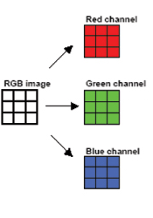
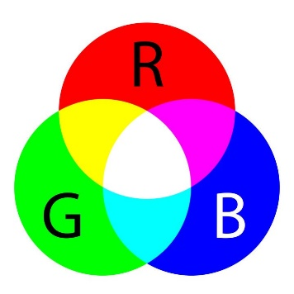
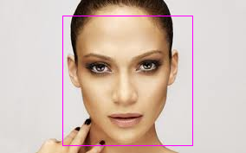

HOW DO WE DIGITALLY REPRESENT AN IMAGE?: COLORED
Each pixel coordinate (x, y) contains 3 values ranging for intensities of 0 to 255 (8-bit).
RGB image is split into 3 matrices corresponding to red, green, and blue channels.
Any other colour can be created by mixing several intensities of RGB.
Photo Credit: https://hisour.com/rgb-color-model-24867/
Photo Credit: http://www.scielo.org.za/scielo.php?script=sci_arttext&pid=S1816-79502010000100019

Slide 3
HOW DO WE DIGITALLY REPRESENT AN IMAGE?: COLORED
Each RGB pixel has three sets of 8-bit binary numbers which in turn translates into 24 bits of computer information in total, i.e.: '24-bit colour'.
Assuming same number of pixels, RGB image is three times bigger in file size than a Greyscale one.
(255,0,0) Red | (0,255,0) Green | (0,0,255) Blue
(255,255,0) Yellow | (255,255,0) Yellow | (255,255,0) Yellow
Photo Credit: https://hisour.com/rgb-color-model-24867/

